Slide 1
HealthCare Revenue Cycle Management
Presented by:
A. Mohan Vamsi

Slide 2
Problem Statement
Healthcare organizations struggle to manage and analyze complex data from patients, claims, providers, and transactions. The lack of clean, integrated data makes it hard to track revenue, insurance payouts, and claim statuses accurately. A unified data pipeline is needed to streamline healthcare revenue management and support better financial decision-making.

Slide 3
Objective
To build a scalable data pipeline that cleans, transforms, and integrates healthcare data from multiple sources into structured dimension and fact tables. This enables accurate analysis of claims, transactions, insurance amounts, and patient histories, supporting effective revenue cycle management in the healthcare domain.
The project also ensures data consistency using Slowly Changing Dimensions (SCD Type 2), allowing historical tracking of patient information. Ultimately, the goal is to provide a clean and analytical-ready dataset for downstream reporting and decision-making.

Slide 4
Technical Requirements
Data Integration
Extract data from MySQL databases and CSV files.
Combine and transform them into a unified data model.
Data Quality & Governance
Apply data validation and cleansing rules.
Standardize key fields like patient identifiers for consistency.
Historical Data Management
Use Slowly Changing Dimension Type 2 (SCD2) to handle patient history.
Maintain audit trails to support compliance and traceability.
Analytics Infrastructure
Load clean, structured data into Google BigQuery.
Create a dimensional model for flexible, self-service analytics and reporting.

Slide 5
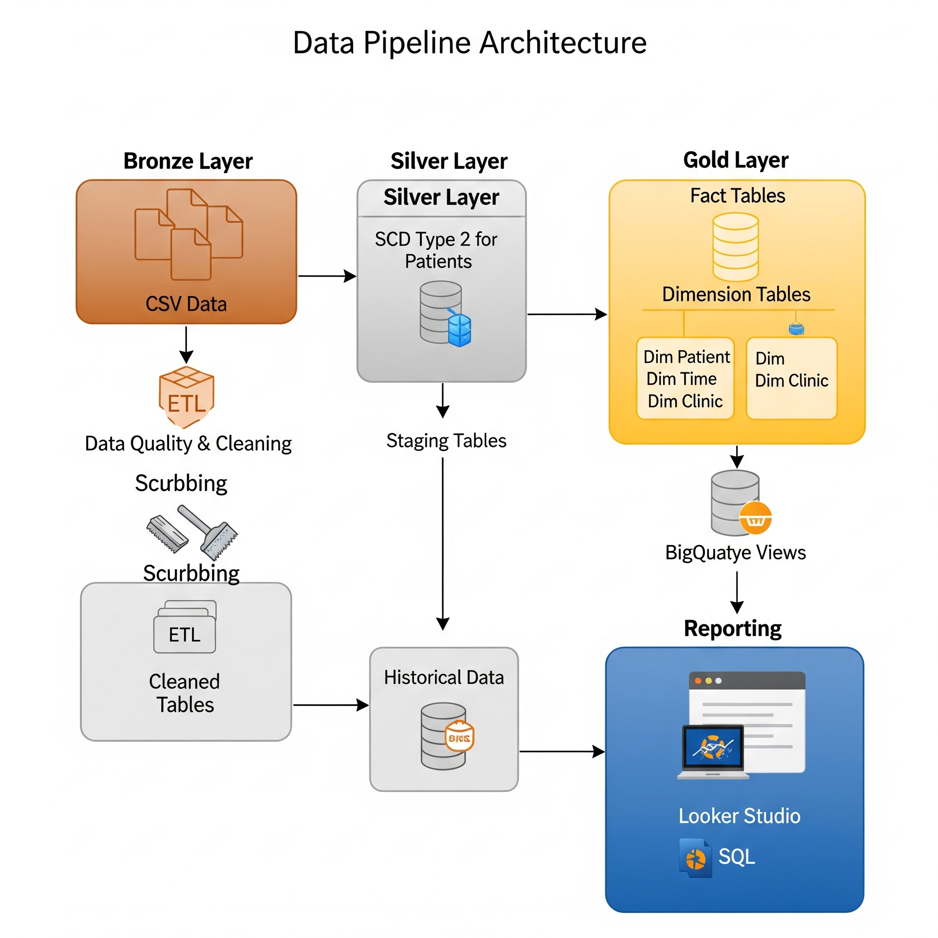

Slide 6
BigQuery Architecture
Bronze Layer: Raw data ingested from MySQL & CSVs, stored without changes for traceability.
Silver Layer: Cleaned, validated, and integrated data. Joins applied between claims, patients, providers.
Gold Layer: Analytics-ready. Includes dimensional models, SCD Type 2 history for patients, optimized for reporting.
Output: Processed data loaded into BigQuery with clean fact & dimension tables for healthcare analytics.

Slide 7
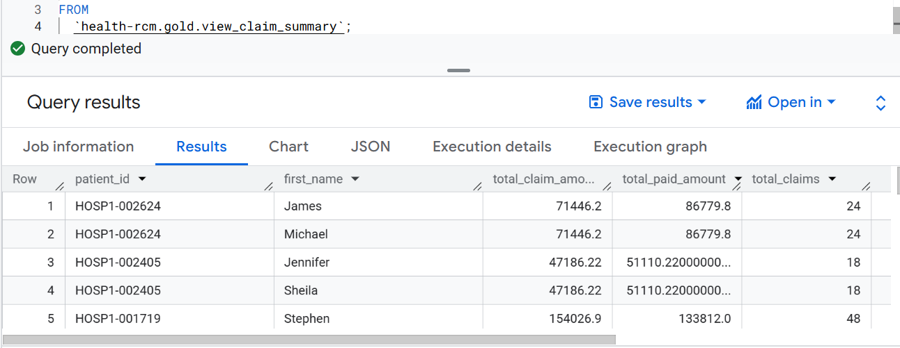
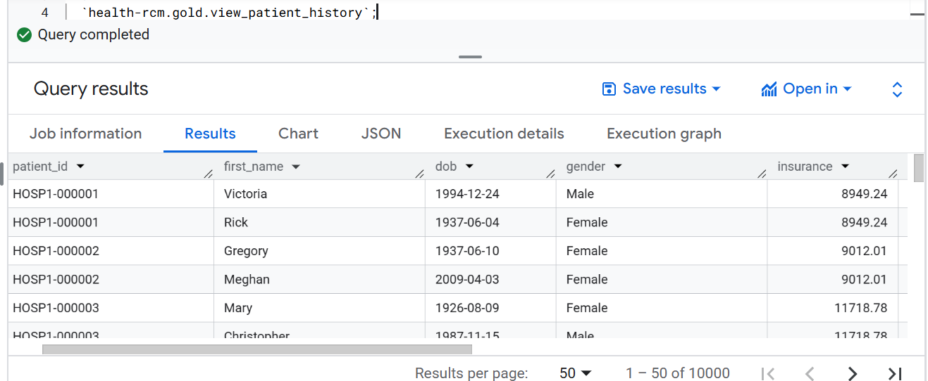

Slide 8
Key Learning Outcomes
• Database Integration: Connected multiple MySQL databases and managed connections efficiently. • ETL Pipeline Development: Built robust pipelines for data extraction, transformation, and loading. • Data Quality Management: Applied validation, cleansing, and error handling for clean datasets. • Dimensional Data Modeling: Designed efficient star schema for improved analytical performance. • SCD Type 2 Implementation: Tracked historical changes in patient data using SCD Type 2 logic. • Cloud Data Warehousing: Leveraged Google BigQuery for scalable and optimized data storage.

Slide 9
Conclusion
Successfully built a healthcare data warehouse using Google BigQuery.
Implemented end-to-end ETL pipelines from raw ingestion to gold-layer analytics.
Ensured data quality, consistency, and historical tracking with SCD Type 2.
Enabled self-service analytics through structured dimensional models.
Project demonstrates real-world healthcare data integration and warehousing best practices.

Slide 10
THANK YOU

